Slide 1

Group - Project Ticket Booking Platform

Slide 2
Road Map
The application development will proceed through the following phases:
Development using Core Java and JPA integrated with Hibernate.
Integration of Spring Boot, Rest Controller, and JPA with Hibernate.
UI design utilizing Angular (Front End) and its integration with the functionalities developed in the previous phase.

Slide 3
Plan
The design process will be as follows:
Skeleton Generation: Create a framework based on the provided class design.
Test-Driven Development (TDD) Approach:
Identify test scenarios for each module.
Draft the initial failing test cases.
Modify and refine until all test cases pass (turn them GREEN).
Incremental Implementation: Develop the case study step by step, ensuring each phase builds upon the last.

Slide 4
Modules
Login Module
Customer Module
Event Management Module
Screen Management Module
Ticket Booking Management Module
Theatre Management Module

Slide 5
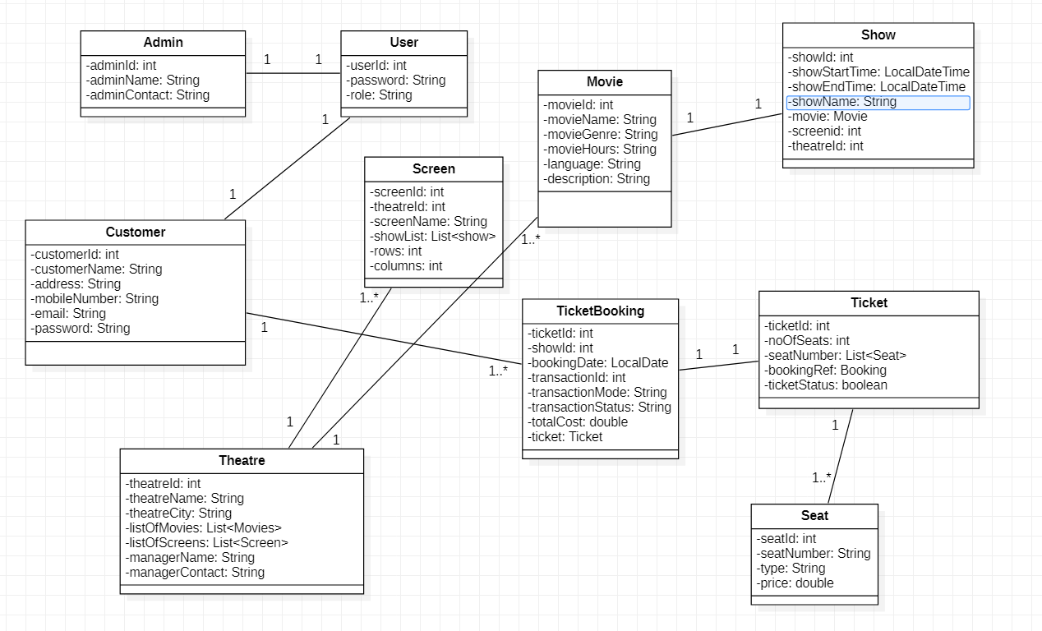
Class Diagram

Slide 6
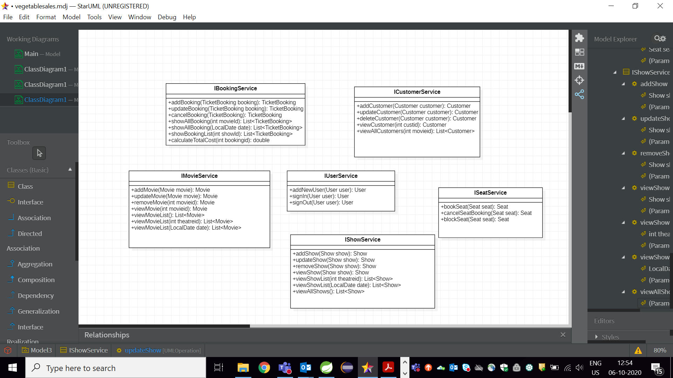
Service Interface

Slide 7

Repository

Slide 8


Slide 9
Thank You

